Slide 1

PACE Computing Project Semester 2 2022
Gun Violence in the USA – End of Project Showcase

Slide 2
AGENDA
Welcome | 01
Problem Statement | 02
Business Requirements | 03
Approach | 04
Backend | 05
06 | Frontend
07 | Value
08 | Future Considerations
09 | Q & A

Slide 3

01 Welcome
John Citizen
B.IT.BBIS & Business Analysis
Role: Project Manager
The Team

Slide 4









02 Problem Statement
John Citizen
EY Data & Analytics has been provided with multiple data sources that contain information related to gun violence in the United States. | Analyse this data and build an end-to-end solution that allows the ingestion of data sources into a consolidated data model, which will be fed into a centralised analytics dashboard. | The dashboard is to provide insight into gun violence across the United States in relation to risk, safety, geography, etc and must address a set of business requirements.
Data Sources
Pipeline & Storage
Dashboard Platform
Azure Functions
Azure Blob Storage
Azure MySQL
PowerBI

Slide 5






03 Business Requirements
John Citizen
Use Azure Services: EY is a Microsoft partner and would like to use Azure Services
Anonymised Data: Data should be stripped of PII. For example, name, address, mobile phone etc.
Real-time Dashboard: The data displayed on the interactive report should be periodically refreshed
Data Visualisation: Additional metrics should be included in the interactive report, i.e. types of gun used, age, location, geographic heatmap
Interactive Report: An interactive report in the form of a data visualisation dashboard that provides meaningful insight
Agile Delivery: The project should follow the iterative Agile delivery method.

Slide 6
04 Approach
John Citizen
Proof of Concept
How do we create it?
Establish blueprints, guardrails, and high level solution designs
Design & Requirements
Outline the high level design and requirements of the solution
Agile Sprints
What are we actually developing?
Breakdown of user stories and activities to achieve outlines deliverables and milestones
Test
Does it work?
Define
What are we trying to do?
Define the problem statement, scope, issues and challenges
Backlog
Sequenced activities or capabilities to be built or implemented
Repeat

Slide 7
John Citizen
John Citizen
John Citizen
05 Backend Development

Slide 8







Options Analysis
John Citizen
Option 1 | Option 2 | Option 3
Slow data access Reliance on functions | DB option is 4x faster than Option 1 Data Factory incurs additional costs possibly unnecessary | All services integrate well with each other DB option is 5x faster than Option 1 Most expensive option
Estimated Monthly: $16.25 USD | Estimated Monthly: $21.54 USD
PostgreSQL (120 IOPS)
Azure Functions
MySQL (500 IOPS)
Azure Functions
Data Factory
MySQL (640 IOPS)
Data Factory
Synapse (Optional)
Cheapest option
Estimated Monthly (Synapse): $97.44 USD
Estimated Monthly: $28.54 USD

Slide 9
Our Solution
Heavy use of functions is cheaper than Data Factory
Fast storage and export to Power BI
Cost effective and efficient solution
Reliance on functions complicates codebase
MySQL (500 IOPS)
Azure Functions
Option 1 Option 2 | Azure Functions for all pipeline activities. Ingesting/Transforming/Uploading data. Azure MySQL database for user access layer (500 IOPS).
Estimated Monthly: $21.29 USD
Notes:
Is this one of the 3 options?

Slide 10
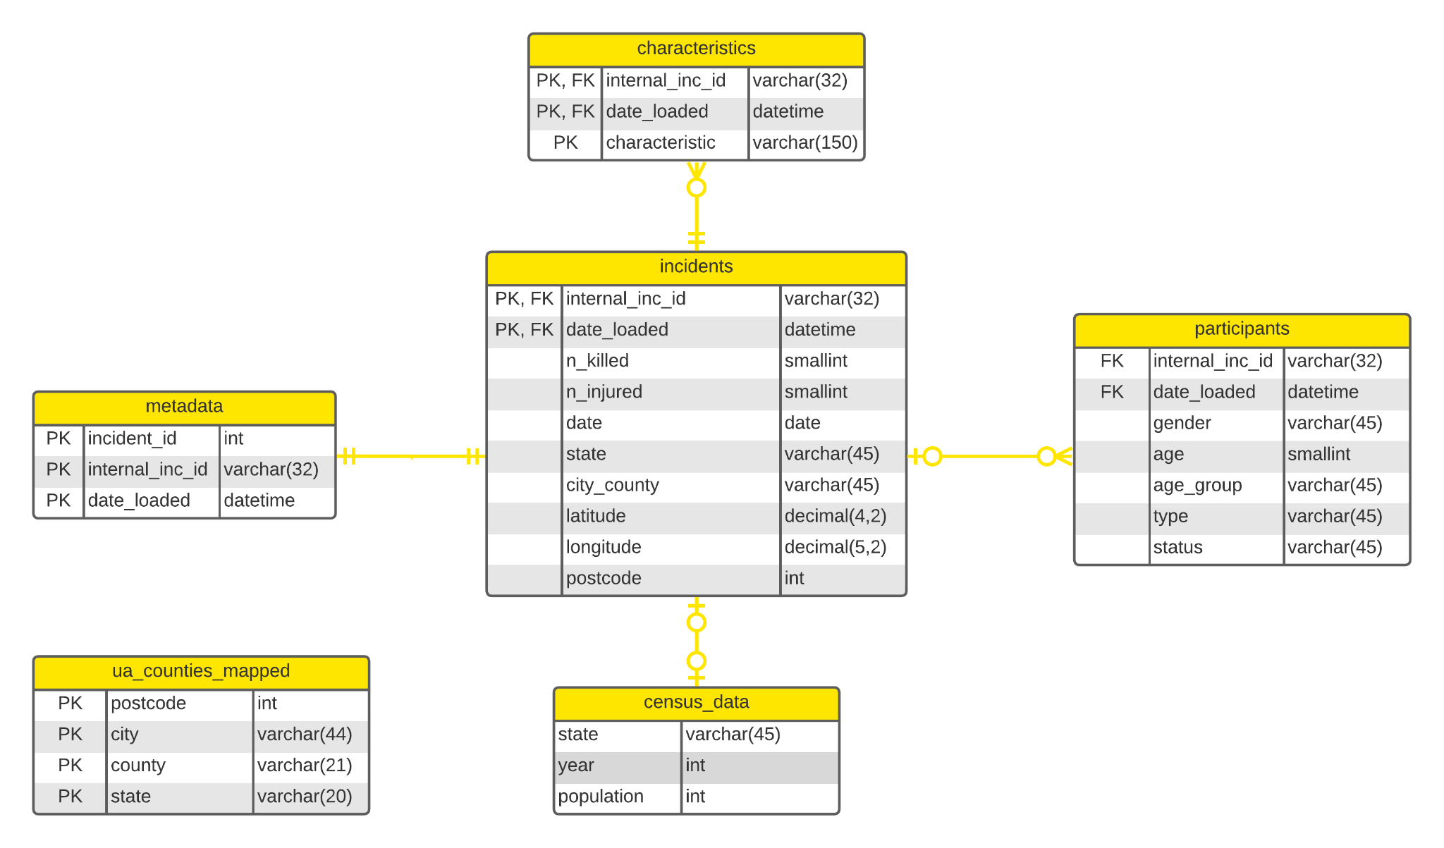
Data Model
Note: Helper table for Frontend use.
Notes:
Ppt styles, formatting

Slide 11
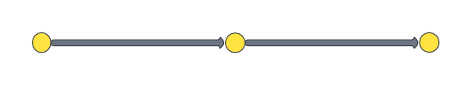
Data Quality
A
B
Source
Staging Layer
Consumption Layer
Unit Testing and Integration Testing of code before converting to Azure Functions. Combined with end to end testing of the pipeline
B. DAMA Framework to check data quality within consumption layer. Additionally a dashboard was made to monitor data quality dimensions
Completeness - Tracks null values in the database
Consistency - Tracks distinct classification of records
Timeliness - Tracks updation of data within the database
Validity - Validation of columns within the database
Uniqueness - Tracks duplication within the database

Slide 12





Approach to Data Collection
Individual Incident Web Scraping | Export Tool without Filtering | Export Tool with Filtering
Best data quality No need to enrich location (lat/long is provided) High probability of IP ban Extremely slow (5 seconds per incident) | No chance of IP ban Fastest data collection (Avg runtime for a 3 day date range: 5-10 seconds) Poor data quality Additional API is required to enrich location later | Great data quality No chance of IP ban Average runtime for a 3 day date range is 80 seconds Additional API is required to enrich location later
Notes:
How fast?

Slide 13

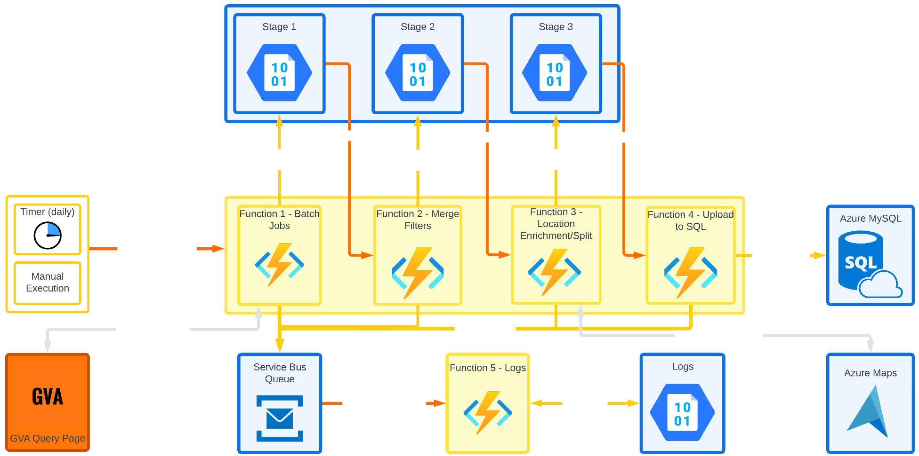
Pipeline Architecture
Finn Tolmie
Legend
Trigger Input
Input/Output
External Requests
Notes:
Formatting- icons not same sized, fix line colours, words and lines

Slide 14
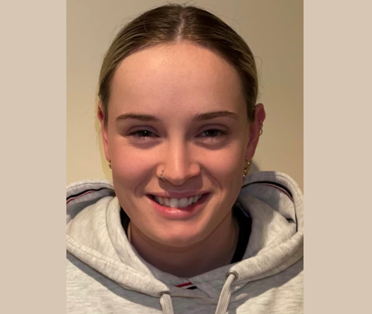

Ashlee Soutar
Chris Austin
06 Frontend Demonstration

Slide 15
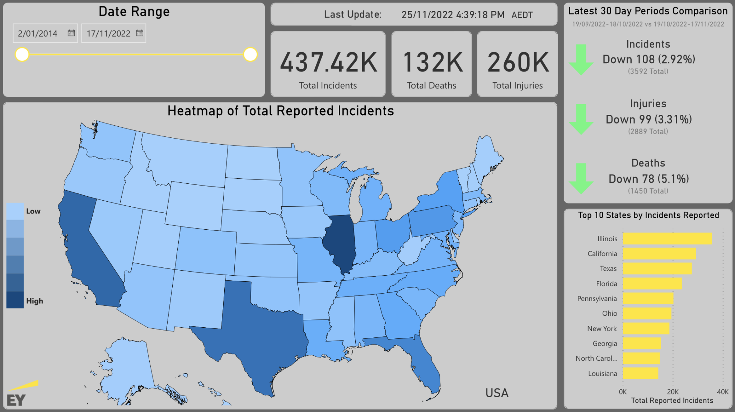
Primary Page
Ashlee Soutar
Notes:
Live demo, make demo backup vid

Slide 16
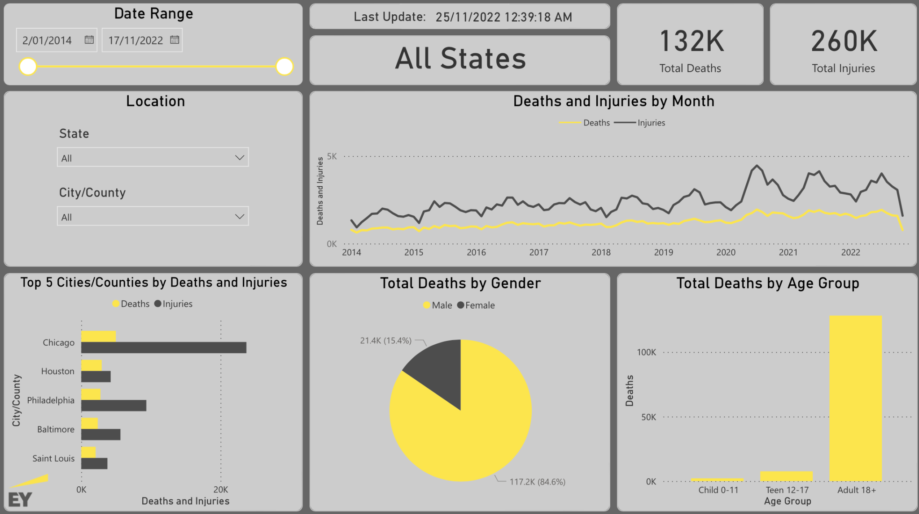
Summary Page
Ashlee Soutar

Slide 17
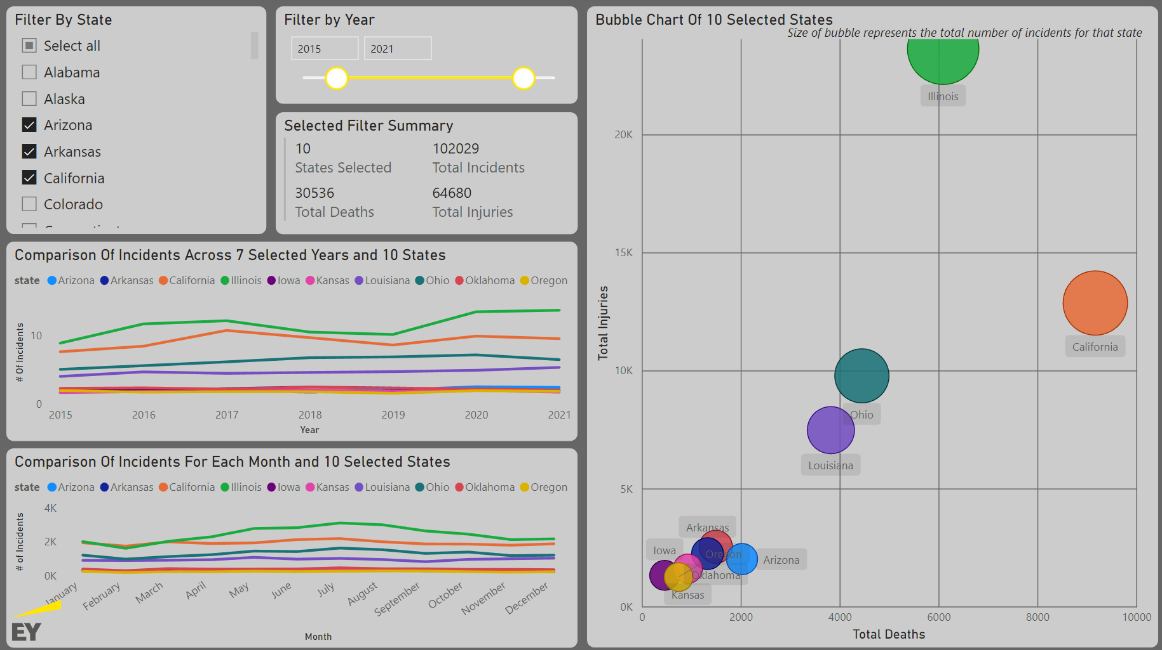
Comparison Page
Chris Austin

Slide 18
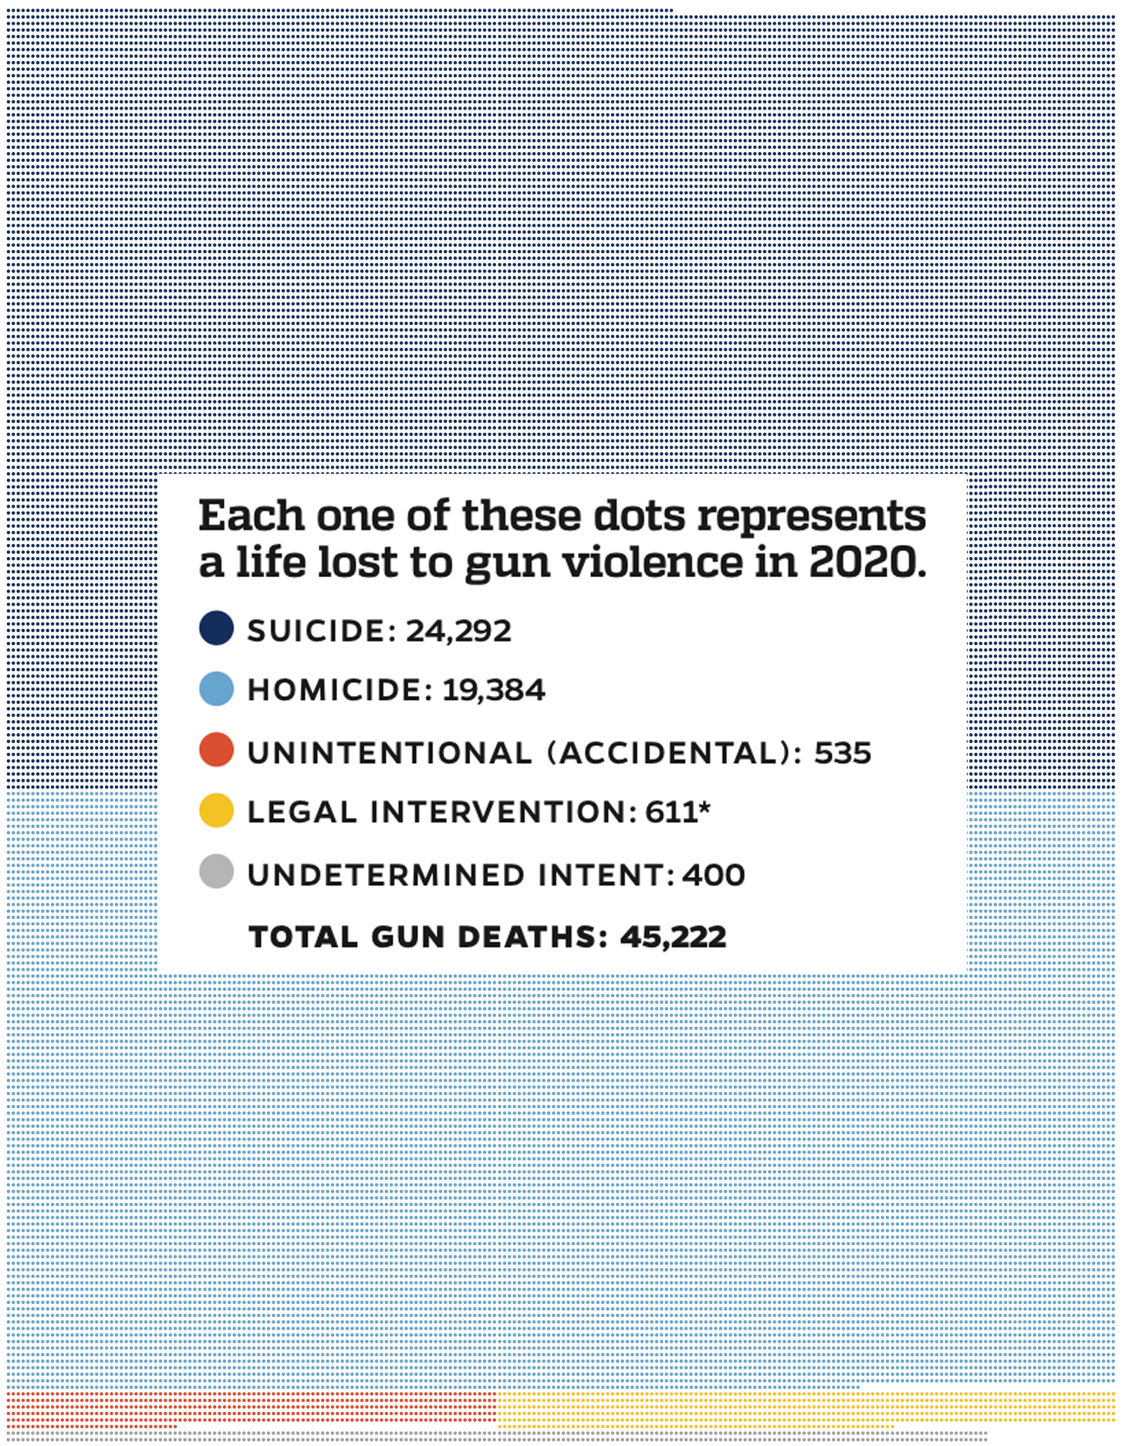
07 Value
Chris Austin
[Part of] The Problem:
Gun Violence In America
- 2020 had the most gun-related deaths on record at the time
- 2021 beat that record by an additional 3500
[Part of] The Solution:
Knowledge
The Goal:
An interactive dashboard with accurate, clear and relevant visualisations of US gun-related violence
The User:
Anyone with an interest in gun-related violence statistics and trends (politicians, police, businesses, etc.)
The Benefit:
By having easy access to US gun violence information, stakeholders can make more informed decisions that may:
1. Help prevent future gun violence
E.g.: politicians and police knowing which geographical areas to focus on
2. Increase the safety of individuals or businesses
E.g.: Researching where would be a safer place to live or start a business
Incident ID | Incident Date | State | City Or County | Address | # Killed | # Injured
1466705 | August 3, 2019 | Texas | El Paso | 7101 Gateway Blvd | 23 | 23
1467828 | August 4, 2019 | Ohio | Dayton | 419 E 5th St | 10 | 17
Source: Johns Hopkins Center for Gun Violence Solutions. (2022). A Year in Review: 2020 Gun Deaths in the U.S. Available: https://publichealth.jhu.edu/gun-violence-solutions

Slide 19


08 Future Considerations
Joel O’Donnell-Goodman
Yarra Masad
Data Engineering & Data Modelling Completed Location enrichment Ingesting 2018-2022 historical data Integrating front-end with dynamic data Connect participants and incidents Future Enhancements Implement checksums for data ingested into blobs Database migration Ensure data immutability for participants table Backend optimisations (execution time, reliability) | Data Visualisation & Analysis Completed Improvement of data availability at state-level for drill-down feature on heatmap Implement Comparison Page Transfer to dynamic data set Source real-time data from dynamic dataset Cross visual drill down levels are synced but maintain the data accuracy Future Enhancements Implement a greater variety of metrics into the heatmap Incorporation of Gun Data into the Summary Page
Notes:
Vis -
add different metrics for heatmap (like heatmap of injuries or deaths, in addition to incidents)
Incorporate gun data into summary page/create a new page

Slide 20







09 Q&A
Yarra Masad
B.IT.BBIS & Business Analysis
Role: Project Manager
Ashlee Soutar
B.IT.Software Technology
Role: Frontend Engineer
Joel O’Donnell-Goodman
B.IT.BBIS
Role: Backend Engineer
Finn Tolmie
B.IT.Web Dev
Role: Data Engineer
Eric Rottger
B.IT.Data Science
Role: Data Modeler
Thomas Yiu
B.IT.Data Science B.Actuarial Studies
Role: Data Analyst
Ashwanth Sai
B.IT.Software Technology
Role: Data Modeler
Chris Austin
B.AdvIT & Business Analysis
Role: Business Analyst
Dalia Alsuwayt
B.IT.Software Technology
Role: Backend Developer
Jeeniya Singh
B.IT.BBIS
Role: Design Analyst
Adi Sharma
B.IT.CybSec
Role: Business Analyst
Hsin Lee
B.IT.CybSec
Role: Design Analyst

